Slide 1








Qudra | قدرة
Demonstrated Skills
Employer Needs
Turn skills into evidence.
Connect talent with opportunity.
An AI-powered platform helping young people demonstrate what they can do—and helping employers discover relevant talent.

Slide 2















Potential is everywhere. Verifiable evidence
is harder to find.
RÉSUMÉ CLAIMS
VERIFIED EVIDENCE
OF CAPABILITY
SKILL ASSESSMENT
Young people can have relevant skills
without strong professional track records.
86%
Problem Solving
Advanced
EDUCATION
Employers need ways to evaluate job-relevant
skills beyond résumé claims.
PRACTICAL PROJECT
Data Analysis Project
Completed
The transition from learning to demonstrating
skills is fragmented.
SKILLS
PEER REVIEW
46.6%
4.7/5
Average Rating
EXPERIENCE
ISSUED VERIFICATION
Blockchain Verified
Credential ID: 7F3A...9B2C
unemployment among Jordanians
aged 15–24 in 2024.
Source: Jordan Department of Statistics, Jordan in Figures 2025 (2024 data).

Slide 3








Qudra makes demonstrated capability easier to evaluate.
From what people say they know, to what they can prove.
CANDIDATE
CHALLENGE
DEMONSTRATED EVIDENCE
EMPLOYER
EVALUATION
Practice and participate
in structured
challenges
Complete structured, multi-phase
submissions
Review and assess evidence to make confident decisions
Build a clear, verifiable record of capability
FOR CANDIDATES
FOR EMPLOYERS
Practice and participate in structured challenges
Demonstrate skills through multi-phase submissions
Build a clear, verifiable record of capability
Create structured, multi-phase challenges
Review submissions and assessment evidence
Discover candidates with relevant demonstrated skills

Slide 4
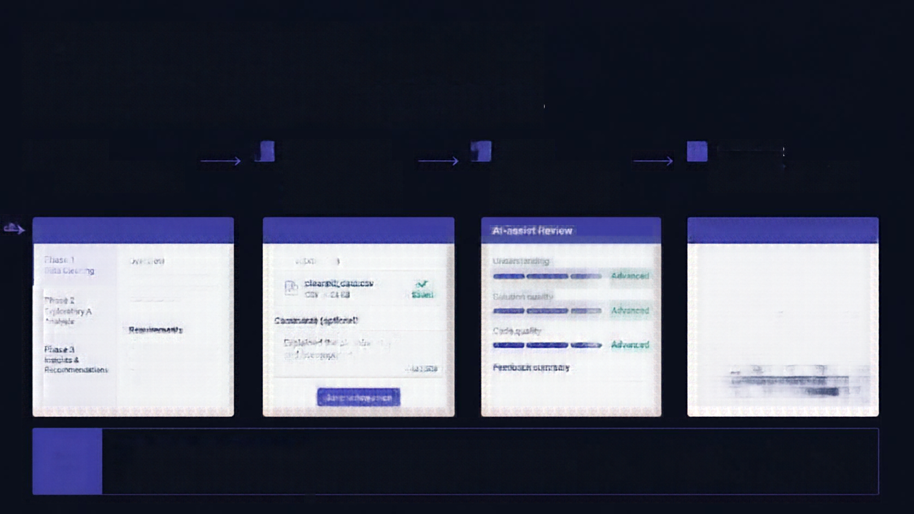









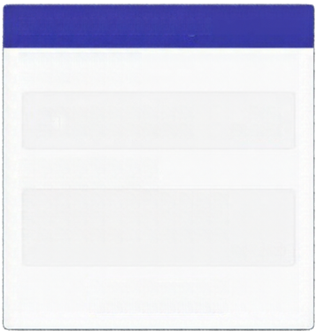














A structured path
from challenge to evidence.
DEFINE
2
DEMONSTRATE
3
ASSESS
DISCOVER
company creates
multi-phase challenge.
candidate completes challenge phases with submissions.
ai-assisted review evaluates submissions and understanding.
employer reviews evidence and discovers talent.
Data Analysis Challenge
Phase 1 Data Cleaning
AI-assist Review
Candidate profile
Phase 1
Data Cleaning
Overview
Your submission
Understanding
Strong performance across all phases
cleaned_data.csv
CSV + 24 KB
Advanced
Phase 2
Exploratory A Analysis
Saved
Solution quality
Challenge progress
Advanced
Requirements
Comments (optional)
Code quality
Phase 1
Phase 2
Phase 3
Phase 3
Insights & Recommendations
Explained the complete steps and assumptions.
Advanced
Overall assessment
48 / 500
Feedback summary
4.7 / 5
Average Rating
Save submission
Advanced
candidates advance by earning it.
Unlock the next phase only after saving a valid submission for the prior phase. Complete the challenge only by passing all required phases.

Slide 5








Not another resume database.
A structured way to demonstrate capability.
Candidate
submission
AI-assisted
assessment
Defined
application rules
Recorded progress and evidence
Candidates complete real-world challenges and submit their work.
AI helps review
submissions and
propose progress
decisions.
Clear rules guide
scoring, progression, and eligibility.
Every step is captured, creating a growing evidence trail.
Employers evaluate candidates on
defined tasks,
not just self-reported skills.
AI supports review and progression decisions
but does not guarantee correctness or fairness.
Structured rules bring consistency, transparency, and accountability to
every decision.
Progress and submissions build richer context than lists of skills.
AI assists but is not the final or unbiased decision-maker. People make the calls. Systems keep the record.

Slide 6

A working product—
not just a concept.
COMPANY CHALLENGE MANAGEMENT
CANDIDATE PROGRESS & SUBMISSIONS
ASSESSMENT & TALENT DISCOVERY
Create and manage structured challenges, track participation, and review submissions.
Candidates complete tasks, submit evidence, and monitor their challenge progress.
AI-powered assessment evaluates capability and surfaces top talent with verified evidence.
1
Select company
account
2
Show structured challenge
3
Switch to
candidate account
4
Show progress
and evidence
5
Explain assessment and progression
Built as a full-stack web application with AI-provider integration and local SQLite persistence.

Slide 7







Start focused.
Validate value.
Scale through evidence.
1
2
3
Demonstrate
Pilot
Scale
Validate workflow with few employers and candidates
Test evidence usefulness
Partner with employers, universities, training providers
Measure engagement and assessment reliability
Expand challenge types
Grow employer participation
Improve assessments
Integrate with training and
talent systems
WHO WE SERVE
WHY IT MATTERS
HOW WE CREATE VALUE
IMPLEMENTATION PATH
Employers and organizations
needing structured
skills evaluation
Better screening evidence
Clearer candidate feedback
Employer subscriptions
Paid challenges
Institutional partnerships
Current demo is prototype
Production requires
authentication, privacy/
security controls,
operational monitoring,
and realuser validation

Slide 8

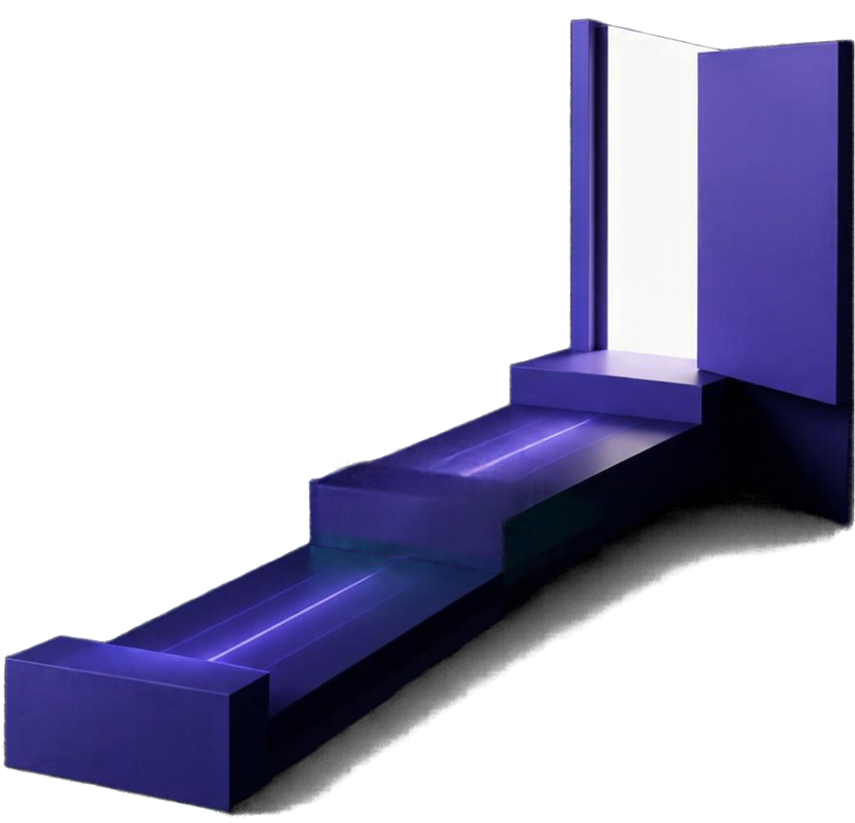

Give capability
a way to be seen.
Opportunity unlocked
Qudra aims to help young people demonstrate what they can do—and help employers make more informed decisions about talent.
Evidence over claims.
Structured challenges over guesswork.
Verified evidence
AI assistance with clear evaluation rules.
Qudra | قدرة
Demonstrated skills
Turn skills into evidence. Connect talent with opportunity.

